Slide 1
Lecture-5 Transformation

Slide 2
Overview
Uses of Transformations
2D Transformations
Basic 2D transformations
Matrix representation
3D Transformations
Basic 3D transformations
Same as 2D

Slide 3
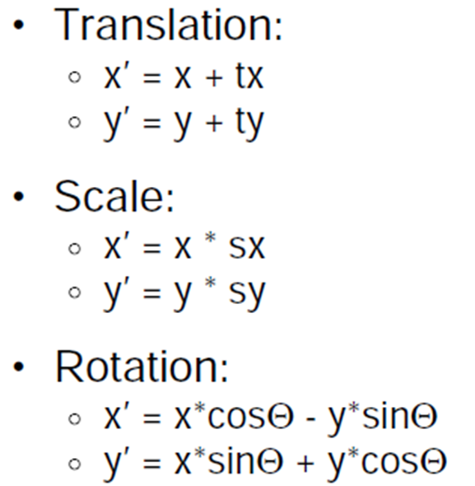
Basic 2D Transformations

Slide 4
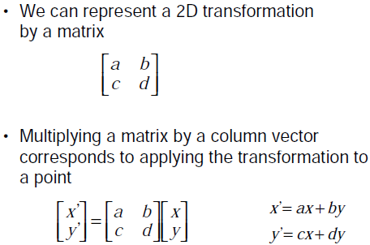
Basic 2D Transformations
Matrix Representation

Slide 5
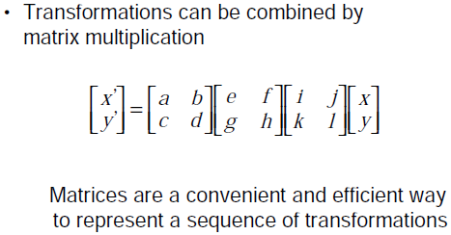
Basic 2D Transformations
Matrix Representation

Slide 6
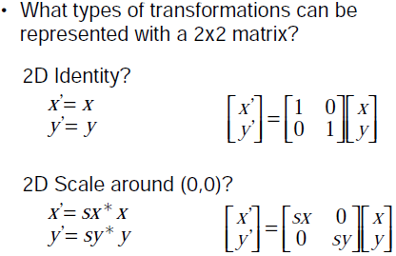
Basic 2D Transformations: Matrix Representation
2x2 Matrices

Slide 7
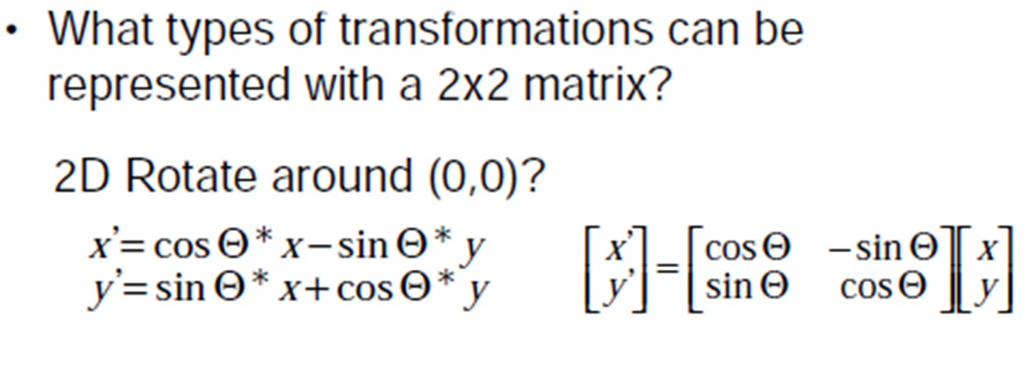
Basic 2D Transformations: Matrix Representation
2x2 Matrices

Slide 8
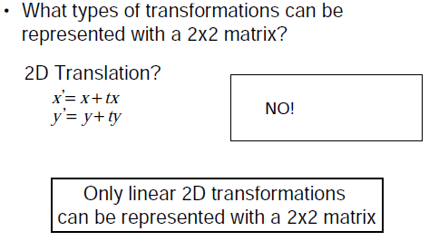
Basic 2D Transformations: Matrix Representation
2x2 Matrices

Slide 9
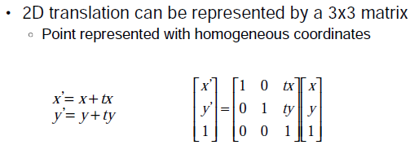
Basic 2D Transformations: Matrix Representation
2D Translation

Slide 10
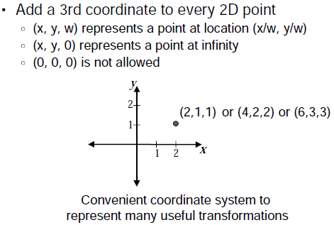
Basic 2D Transformations: Matrix Representation
Homogeneous Coordinates

Slide 11
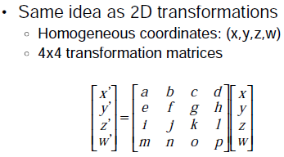
3D Transformations

Slide 12
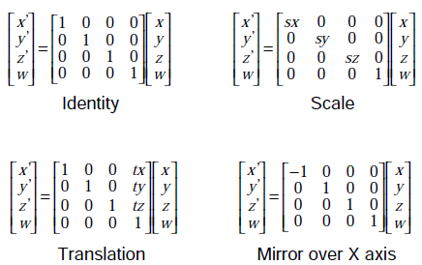
3D Transformations

Slide 13
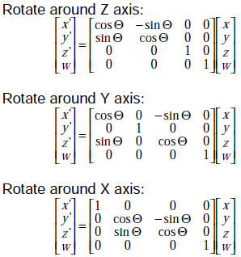
3D Transformations

Slide 14
Thank You

